Slide 1
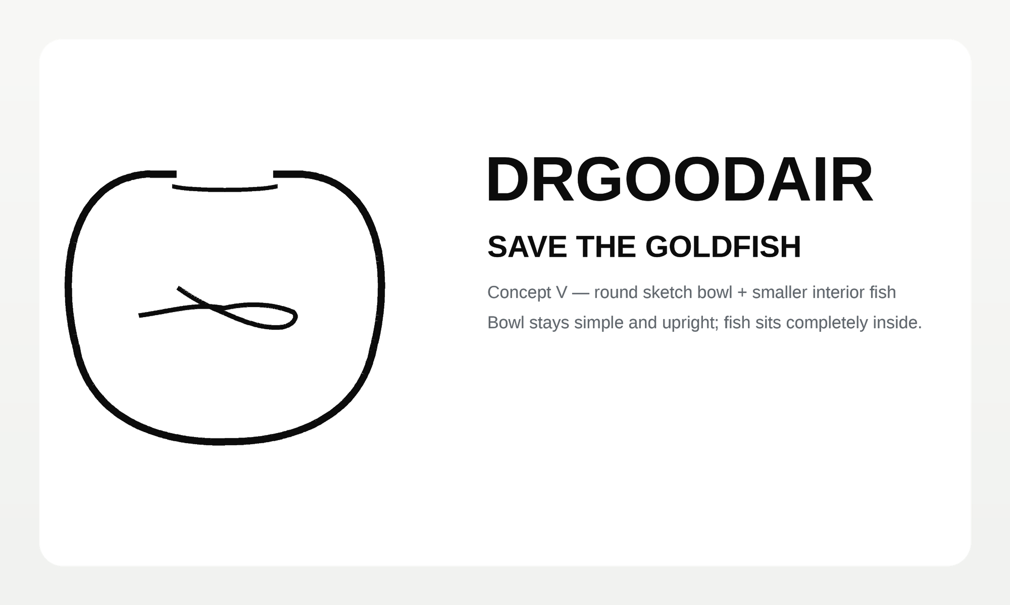
Dr Good Air / Save the Goldfish
Logo Development Presentation Deck
Compiled archive of the concept work produced so far
Covers early brand routes through the selected goldfish bowl direction
Ends with the currently approved “bottom one / V” direction and next refinement steps
Prepared 8 Apr 2026

Slide 2
Project Snapshot
What has been created to date
Narrative arc
Started broad: doctor, airflow, agency, and minimal identity directions
Converged on the goldfish metaphor as the most distinctive route
Iterated heavily on bowl shape: more traditional, more circular, plain top opening
Used the uploaded sketch as a literal template during final refinement
Selected the lower “V” direction and chose a softer, friendlier polish path
54
27
PNG concept boards
PDF review packs
1
1
Primary source sketch
Live review page
Current approved direction

Slide 3
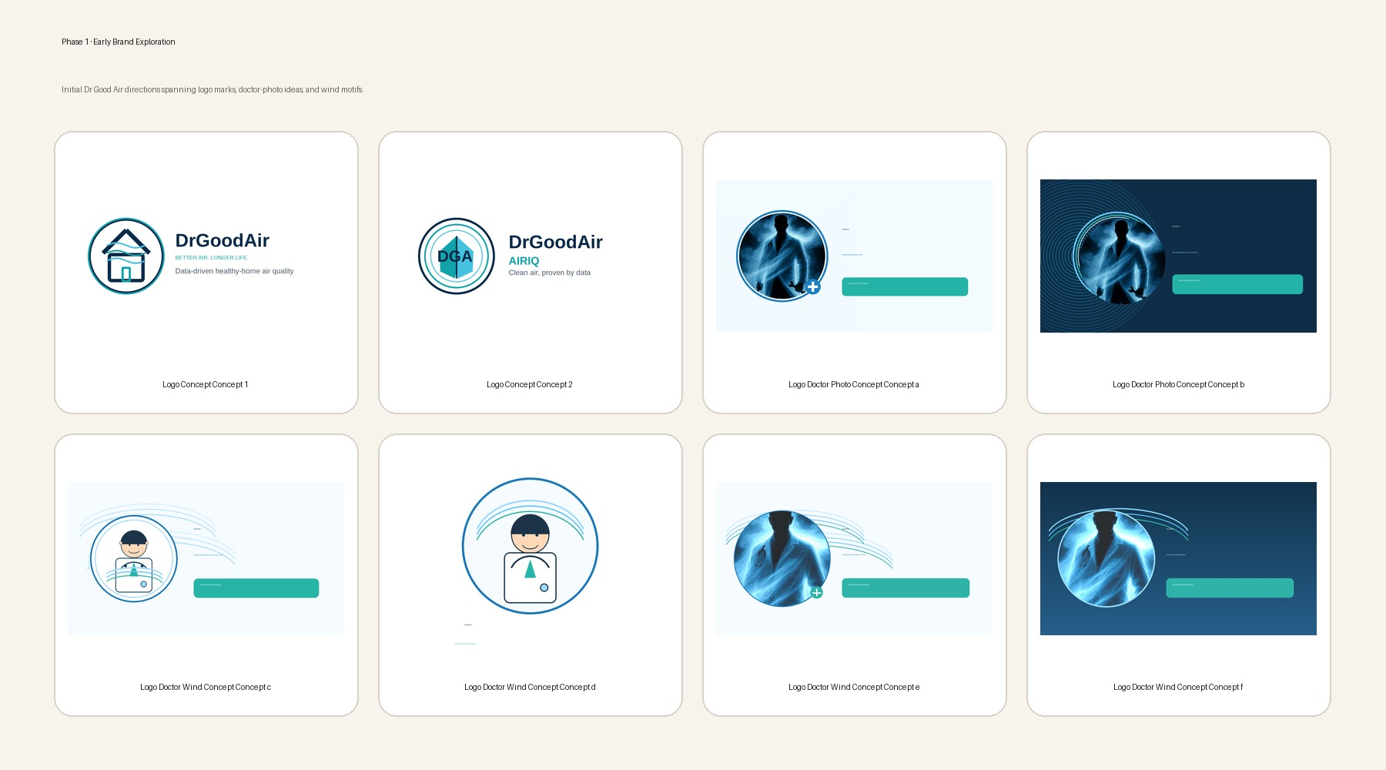
Early Brand Exploration
A wide first pass across doctor-forward and wind-forward brand ideas.

Slide 4
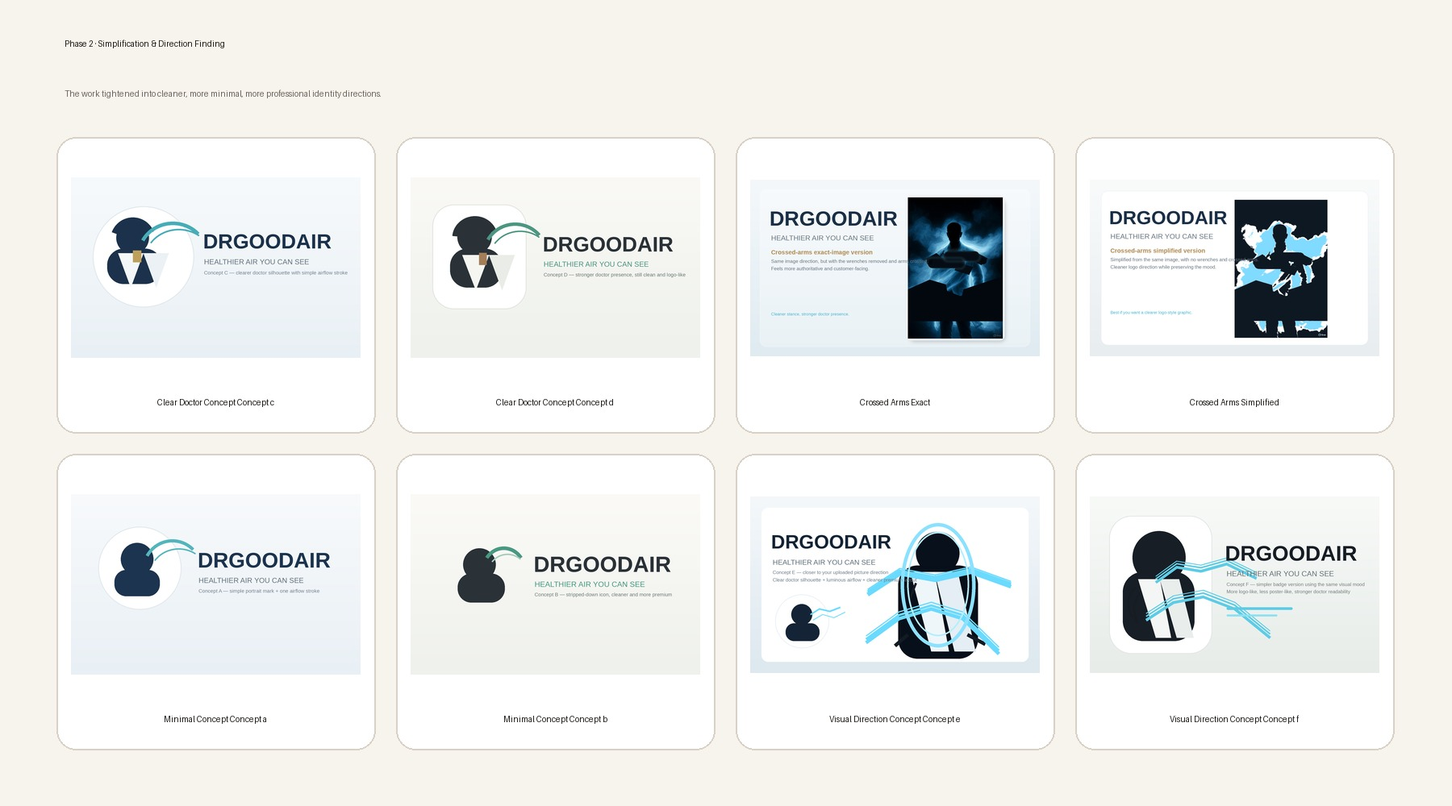
Simplification & Direction Finding
The mark became cleaner, flatter, and more strategic.

Slide 5
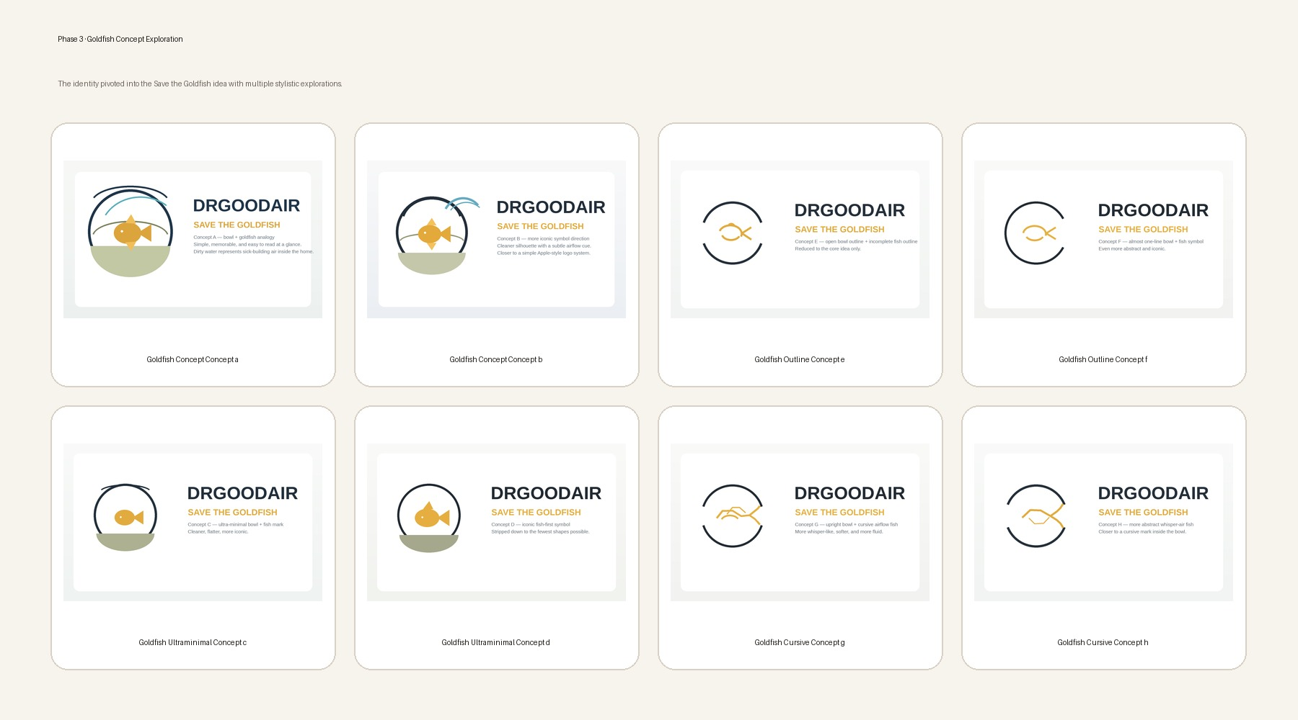
Goldfish Concept Exploration
Multiple tonal interpretations of the new goldfish idea.

Slide 6
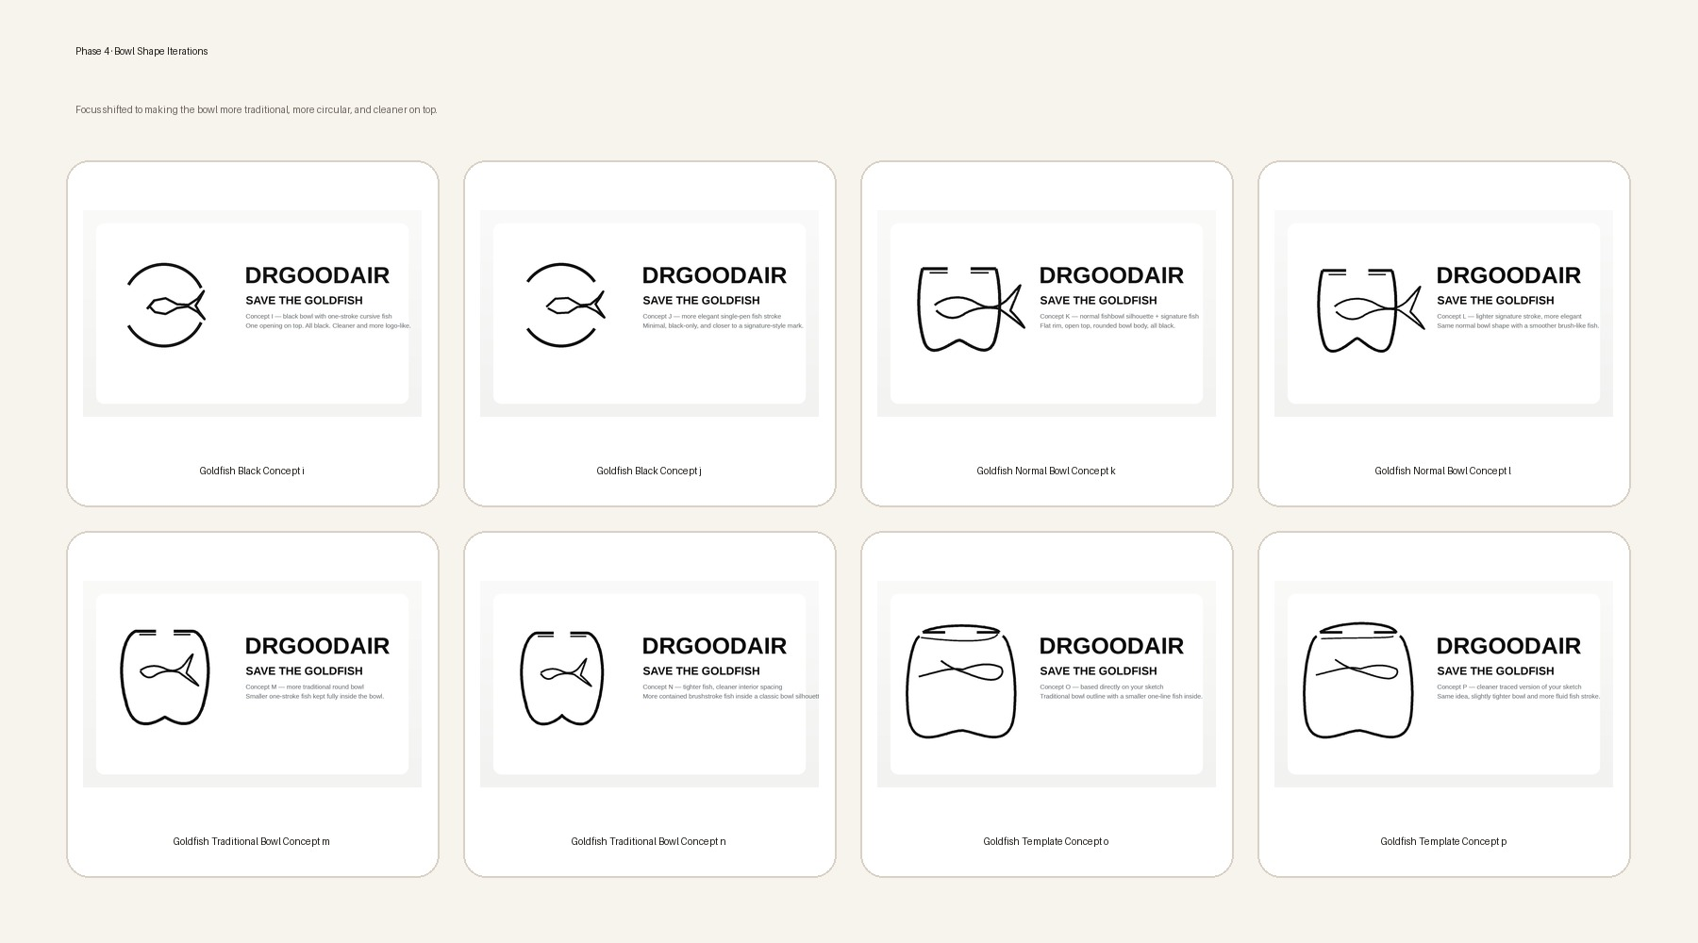
Bowl Shape Iterations
Successive corrections toward a true circular fishbowl silhouette.

Slide 7
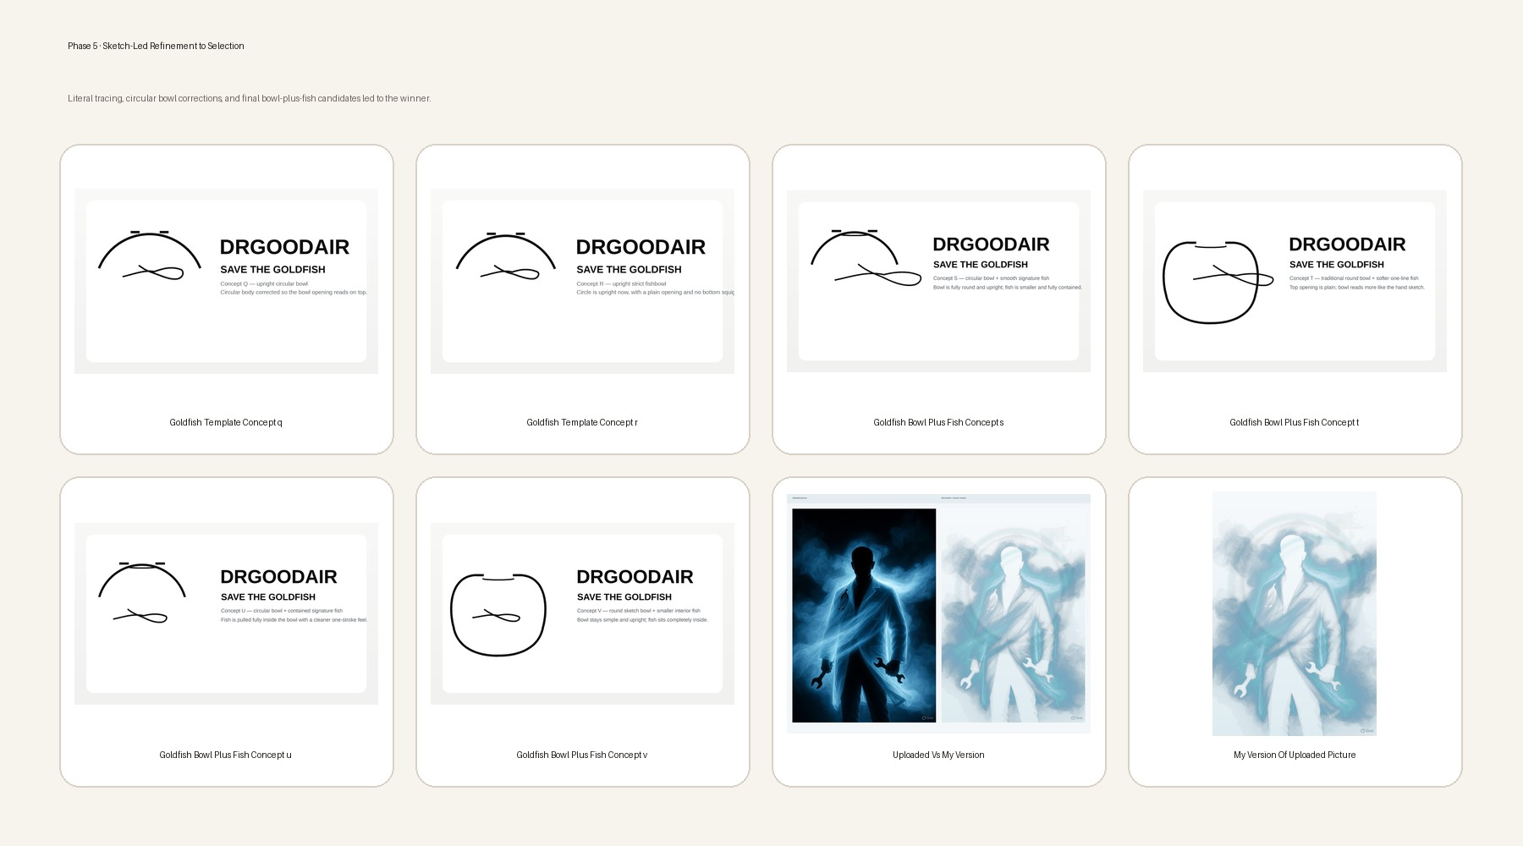

Sketch-Led Refinement to Selection
Literal tracing and bowl/fish corrections led to the selected concept.
Source sketch reference
The uploaded sketch was used as a template during the late-stage bowl refinements.

Slide 8
Selected Direction & Polish Notes
Current winner: bottom concept / V
Bowl should read as literally circular and upright
Top opening stays plain, simple, and centered
Fish remains smaller, fully inside, and shaped by one swooping line
Overall feel chosen for polish: softer, friendlier, elegant, approachable
Wordmark direction was requested next in parallel with icon polish
Recommended next outputs
Final polished icon redraw
Wordmark exploration: serif vs sans
Export package: SVG, transparent PNG, black/white variants
One-page logo usage sheet

Slide 9
Appendix · Output Inventory
Representative files and review packs created during the process
Early identity
Transition work
Goldfish development
Template + final
logo concept 1 / 2
doctor photo concepts
doctor wind concepts
clear doctor concepts
crossed arms exact + simplified
minimal concepts
modern agency redo
professional doctor feel / wisp logo
goldfish concepts a–b
outline e–f
ultraminimal c–d
cursive g–h
black i–j
normal bowl k–l
traditional bowl m–n
template o–p
template q–r
bowl plus fish s–v
literal review PDFs
bowl-plus-fish review PDF
live review page

